Slide 1


Regular Expressions

Slide 2
Agenda
Simple Pattern Matching
What are Regular Expressions
META Characters
▫ Examples
Regular Expression Function
▫ Examples

Slide 3



Simple Pattern Matching
LIKE Operator
%(multiple characters)
_ (single character)

Slide 4

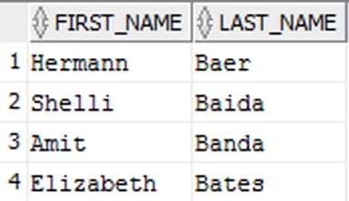


Simple Pattern Matching
LIKE Operator with ‘%”
SELECT first_name, last_name FROM employees
WHERE last_name LIKE ‘Ba%'

Slide 5

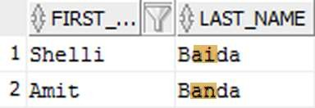
Simple Pattern Matching
LIKE Operator with ‘_’
SELECT first_name, last_name FROM employees
WHERE last_name LIKE ‘Ba_da’

Slide 6
Simple Pattern Matching
What if you needed to find all words where every
second character is a vowel?
Regular Expressions

Slide 7
What are Regular Expressions?
Methods of describing both simple and complex patterns for searching and manipulating
Uses META Characters for pattern matching
Oracle’s implementation is an extension of the POSIX (Portable Operating System for UNIX)

Slide 8


META Characters
Symbol | Description
^ | Marks the start of a line
$ | Marks the end of a line
[ ] | Matching list
| | Operator for specifying alternative matches (logical OR)
? | Matches zero or one occurrence
. | Matches any character except NULL
{m} | Matches exactly m times
{m,n} | Matches at least m times but no more than n times
[: :] | Specifies a character class and matches any character in the class
\ | Escape character

Slide 9
META Characters
Symbol | Description
+ | Matches one or more occurrences
* | Matches zero or more occurrences
() | Grouping for expression
\n | Back-reference expression

Slide 10
META Characters
Examples

Slide 11
^ Beginning of a line
Example: ^(Oracle) | Match
Oracle Open World | √
The Oracle at Delphi | X
Oracle | √

Slide 12
$ End of a line
Example: (Oracle)$ | Match
Welcome to Oracle | √
The Oracle at Delphi | X
Oracle | √

Slide 13
(string1|string2)logical OR
Example: Ste(v|ph)en | Match
Stephen | √
Stefan | X
Steven | √

Slide 14

.(dot) Single character match
Example: re.d | Match
read | √
rear | X
reed | √

Slide 15
. Breakdown (re.d)
Character | Check | Success
r | r e a d r e a r r e e d | √ √ √
e | r e a d r e a r r e e d | √ √ √
. (A-Z,a-z) | r e a d r e a r r e e d | √ √ √
d | r e a d r e a r r e e d | √ X √

Slide 16

{m} Matches exactly m times
Example: s{2} | Match
password | √
sister | X
essential | √

Slide 17
{m} Breakdown (s{2})
password | Check | sister | Check
p | X | s | √
a | X | i | X
s | √ | s | √
s | √ | t | X
w | X | e | X
o | X | r | X
r | X
d | X

Slide 18
*(star) Matches zero or more
Example: ab*c | Match
abc | √
acc | X
ac | √

Slide 19
* Breakdown (ab*c)
abc | Check | acc | Check
a | √ | a | √
b | √ | c | X
c | √ | c | X

Slide 20
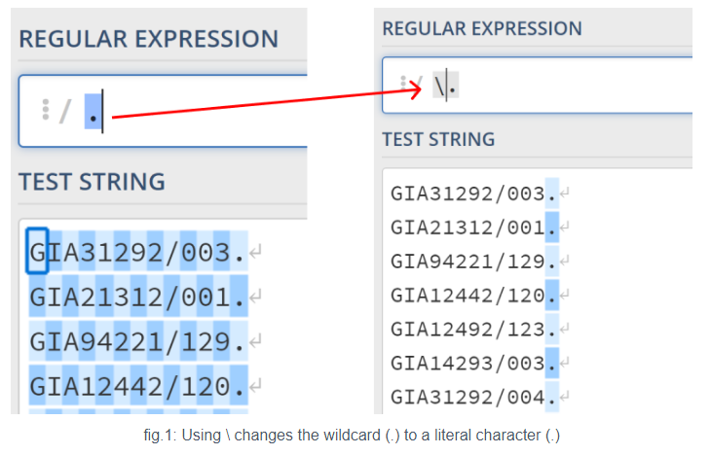
Escaping character: \
An interesting quirk I did get to understand is that backslash characters (\) in meta characters need to be escaped using another backslash (\).
In Regex, meta-characters (i.e. characters that have a special meaning) are "escaped" using a backslash. This means that Regex will treat that character as its literal version rather than a meta-character ().

Slide 21
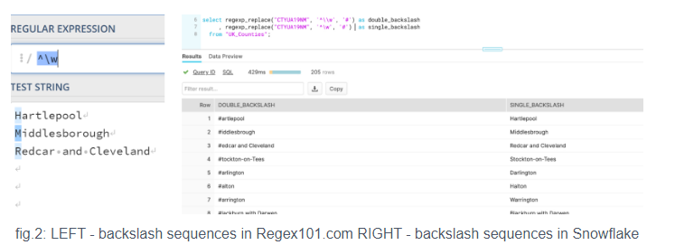
Escaping character: \
Snowflake requires escaping backslash sequences (e.g. \d) for them to work. These are really common meta characters so I'd guess most people feel the frustration early on.

Slide 22
Escaping character: \
Snowflake requires escaping backslash sequences (e.g. \d) for them to work. These are really common meta characters so I'd guess most people feel the frustration early on.
Why is this happening?
The reason is that Snowflake processes the string given (i.e. the Regex pattern) then passes the string to be processed again by the Regex function. This means that Snowflake processes the first backslash before the Regex function has a chance to view it.
So you need to write another backslash (i.e. \\d instead of \d) for the Regex function to process it as intended.

Slide 23
Regular Expression Functions
Set of SQL functions used to search and manipulate strings using Regular Expressions
These functions can be used on any data type that holds character data (CHAR, VARCHAR, CLOB, etc)
The Regular Expression must be enclosed in single quote marks

Slide 24
Regular Expression Functions
Function name | Description
REGEXP_LIKE | Similar to the LIKE operator but allows for the use of regular expressions in matching
REGEXP_REPLACE | Search and replace text using regular expression pattern
REGEXP_INSTR | Searches for a string using regular expression pattern and returns the position when match is found
REGEXP_SUBSTR | Searches for a string using regular expression pattern and returns the matched substring
REGEXP_COUNT | Returns the number of times a pattern appears in the string.

Slide 25
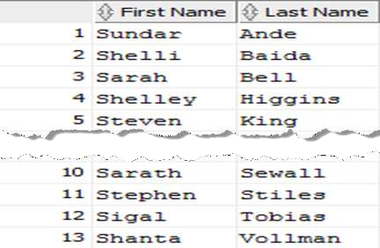
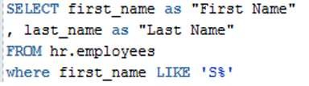
REGEXP_LIKE
Similar to the LIKE operator but allows for the use of regular expressions in matching

Slide 26
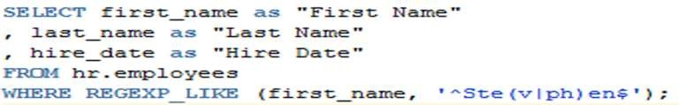
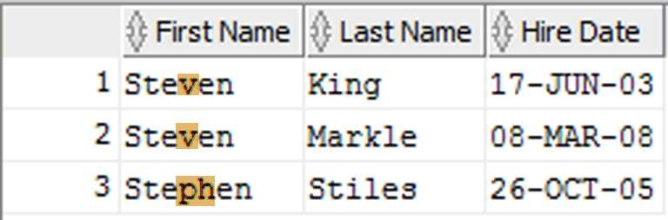
REGEXP_LIKE
All employees first name of Steven or Stephen

Slide 27
REGEXP_LIKE
All employees first name of Steven or Stephen
Meta Character | Description
^ | Start of the string
Ste | Beginning letters of the string
( | Starts the group
v | Is next character a ‘v’
| | OR
ph | Are next characters ‘ph’
) | End the group
en | Ending letters of string
$ | End of the string

Slide 28

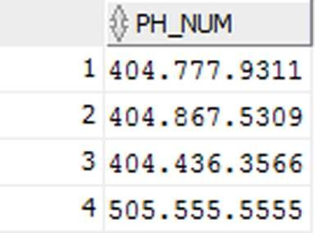
REGEXP_REPLACE
Search and replace text using regular expression pattern

Slide 29

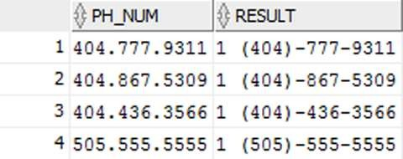
REGEXP_REPLACE
Reformat phone number from ###.###.#### to 1 (###)-###-####

Slide 30
REGEXP_REPLACE
Meta Character | Description
[[:digit:]]{3} | Three digits (group 1)
\. | Then a ‘.’ (Since the ‘.’ is a META Character, we have to use the \ to ‘escape’ it)
[[:digit:]]{3} | Three digits (group 2)
\. | Then a ‘.’
[[:digit:]]{4} | Four digits (group 3)

Slide 31
REGEXP_REPLACE
Replacements | Description (sample 404.777.9311)
1 | Start with a 1
(\1) | Enclose group 1 in () -> (404)
- | Add a ‘-’
\2 | Group 2 -> 777
- | Add a ‘-’
\3 | Group 3 -> 9311
RESULT | 1 (404)-777-9311

Slide 32
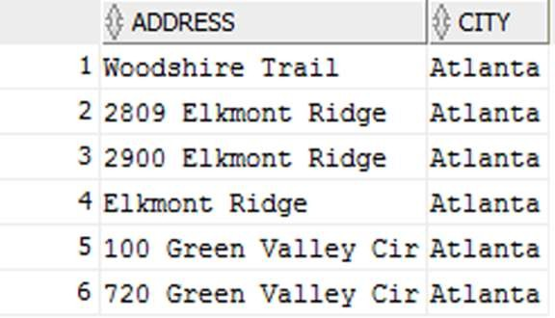
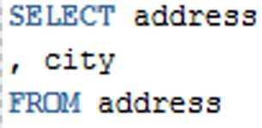
REGEXP_INSTR
Searches for a string using regular expression pattern and returns the position when match is found

Slide 33
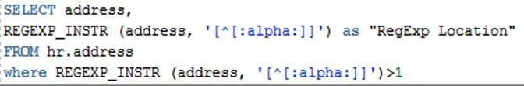
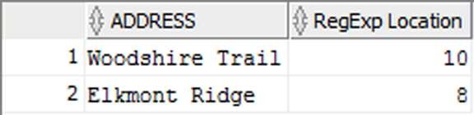
REGEXP_INSTR
Search for addresses that don’t start with a number and list the position of the first non-alpha character

Slide 34
REGEXP_INSTR
Search for addresses that don’t start with a number and list the position of the first non-alpha character
Meta Character | Description
[ | Start of the expression
^ | Starts with
[:alpha:] | Alpha characters
] | End of the expression

Slide 35
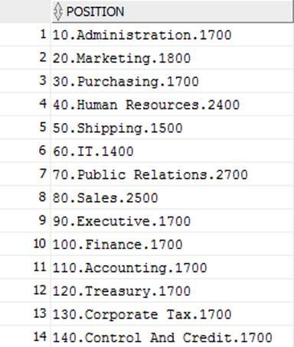

REGEXP_SUBSTR
Searches for a string using regular expression pattern and returns the matched substring

Slide 36
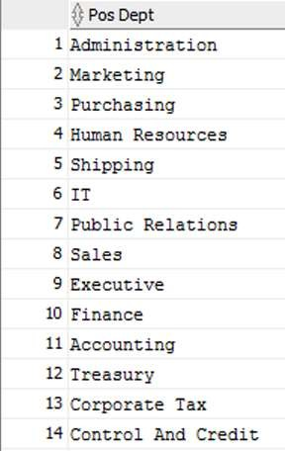
REGEXP_SUBSTR
Only return POSITION department name

Slide 37
REGEXP_SUBSTR
Only return POSITION department name
Meta Character | Description
\. | Escape the ‘.’
[A-z-]+ | Matches one or more occurrences of alpha characters
\. | Escape the ‘.’
1 | Starting position
1 | Nth occurrences
‘i’ | Ignore case
2 | Sub-expression to return

Slide 38
REGEXP_COUNT
Returns the number of times a pattern appears in the string.
Scenario 1: DNA sequence of a mouse. Need to find the number of times the sequence of Cytosine, Adenine, Thymine (cat) proteins occur.
Scenario 2: All rows where there is an ‘i’ in the first name

Slide 39
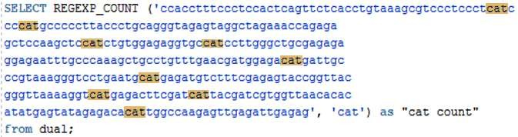
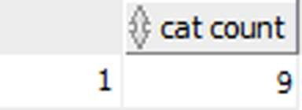
REGEXP_COUNT
Scenario 1

Slide 40
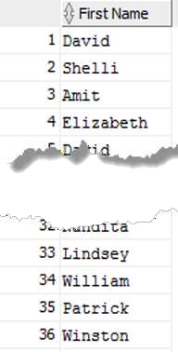
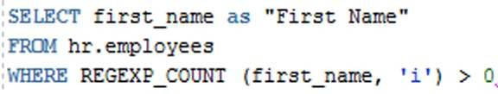
REGEXP_COUNT
Scenario 2

Slide 41

Q/A

